Slide 1

MAT205: Abstract Algebra II
2. Subnormal series
Ma, Jia-Jun

Slide 2
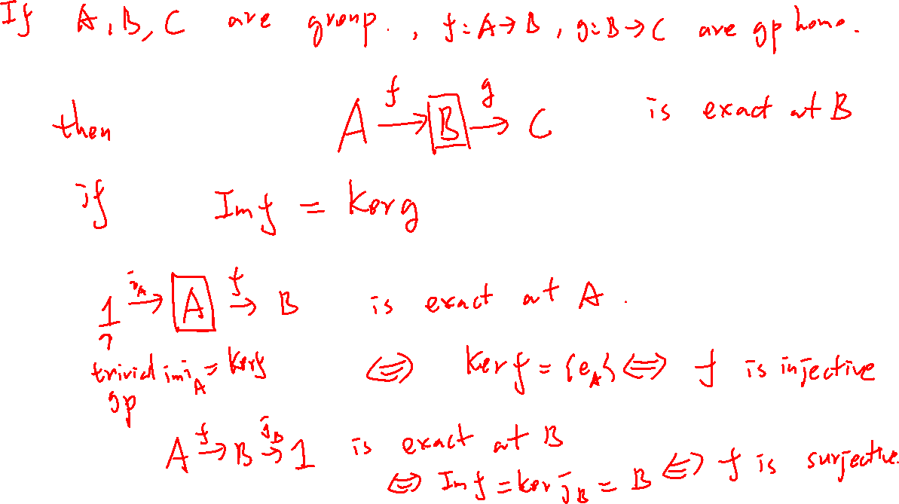


Slide 3
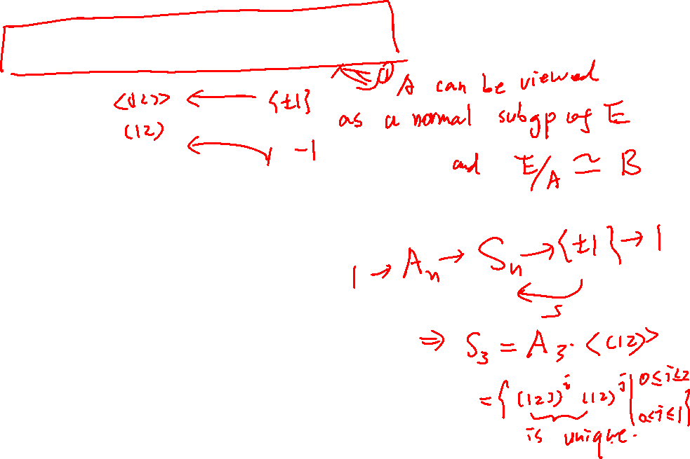
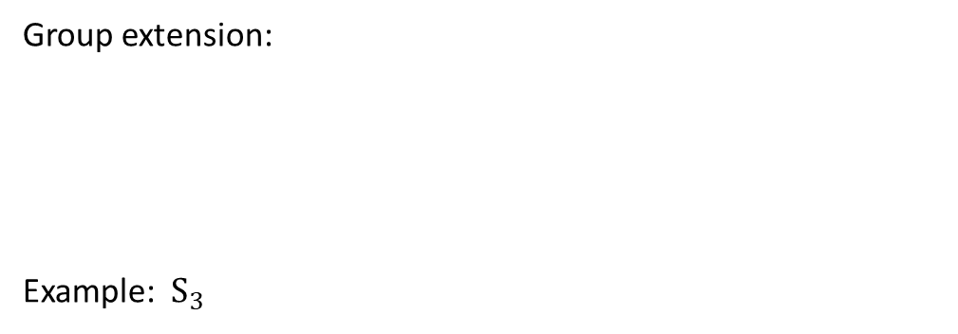
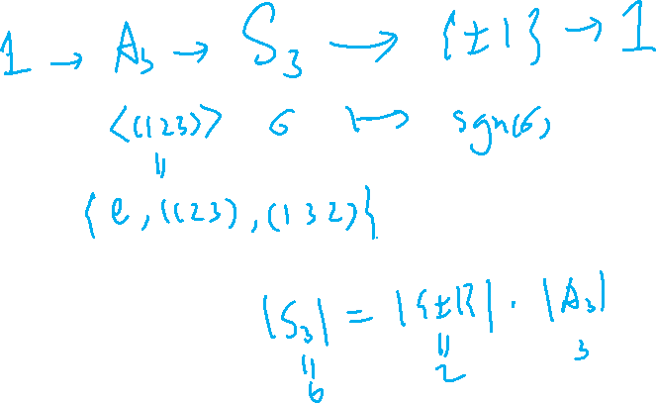

Group extension:
Example: $S_{3}$

Slide 4
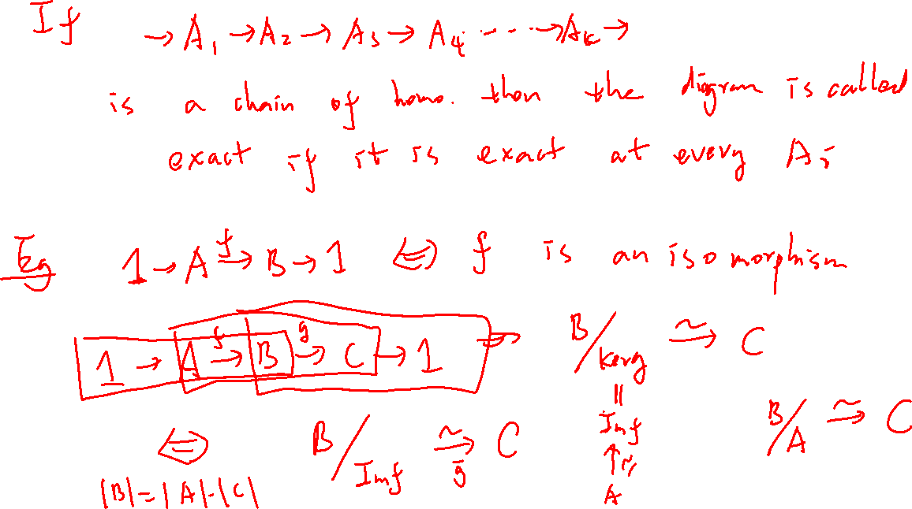

Slide 5
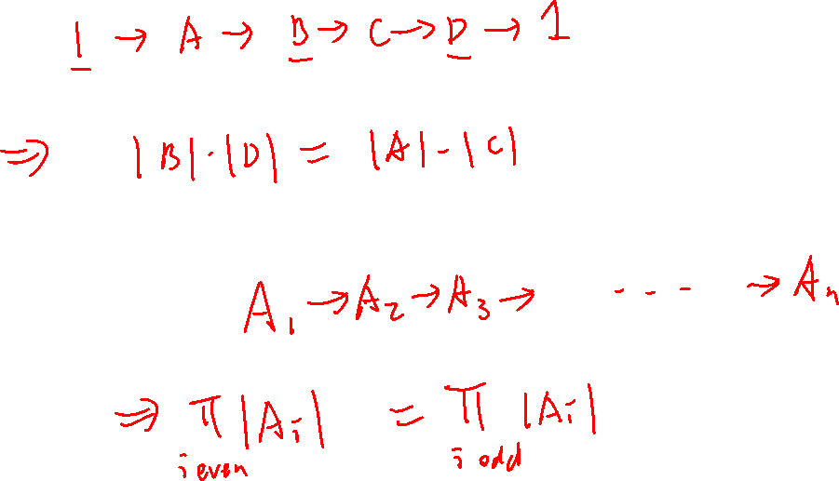
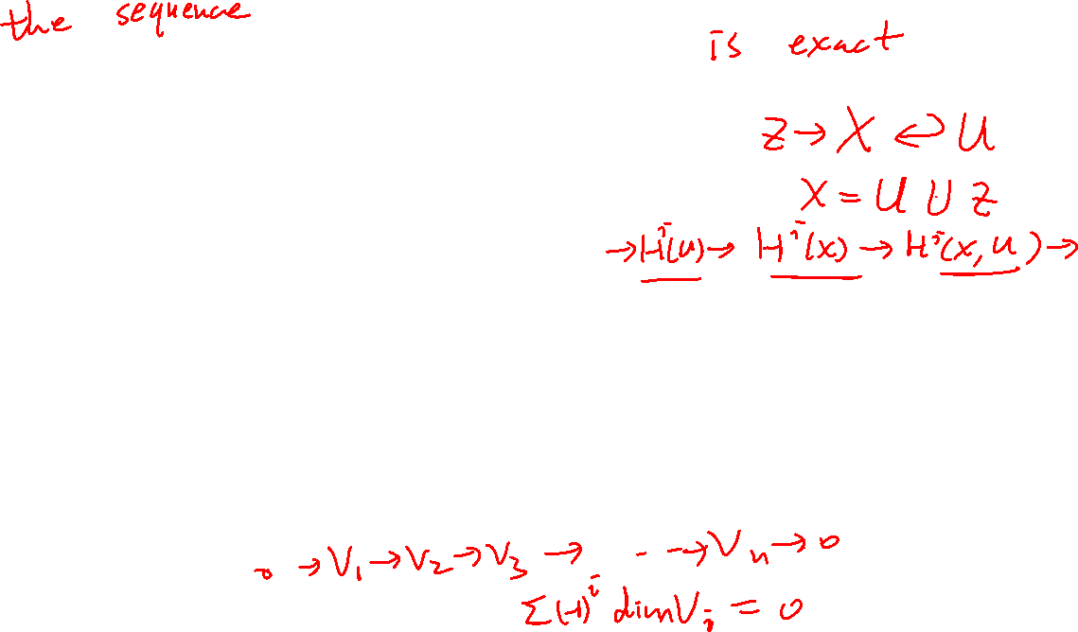

Slide 6
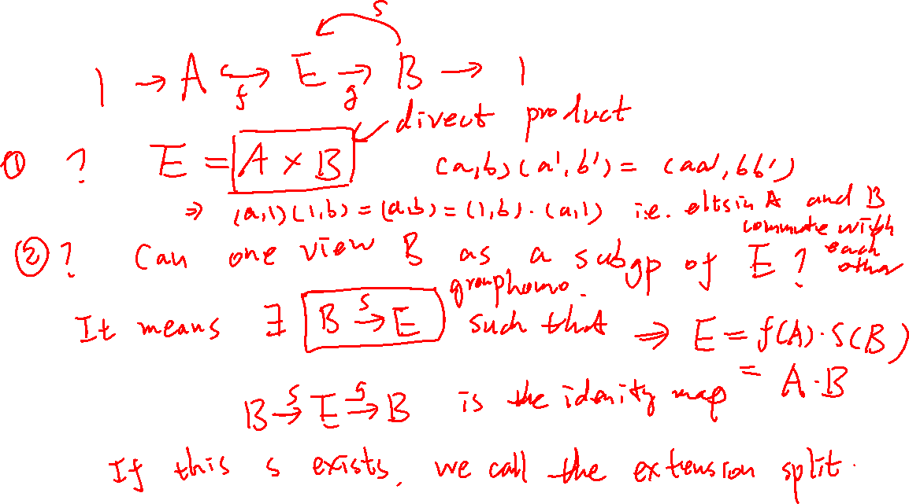
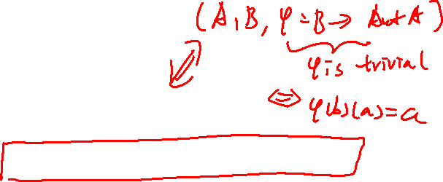

Slide 7
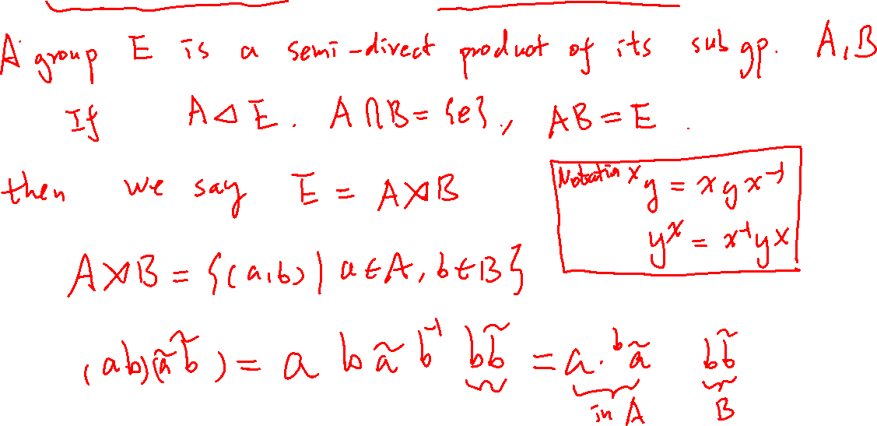
Semi-direct product (Split extension)

Slide 8
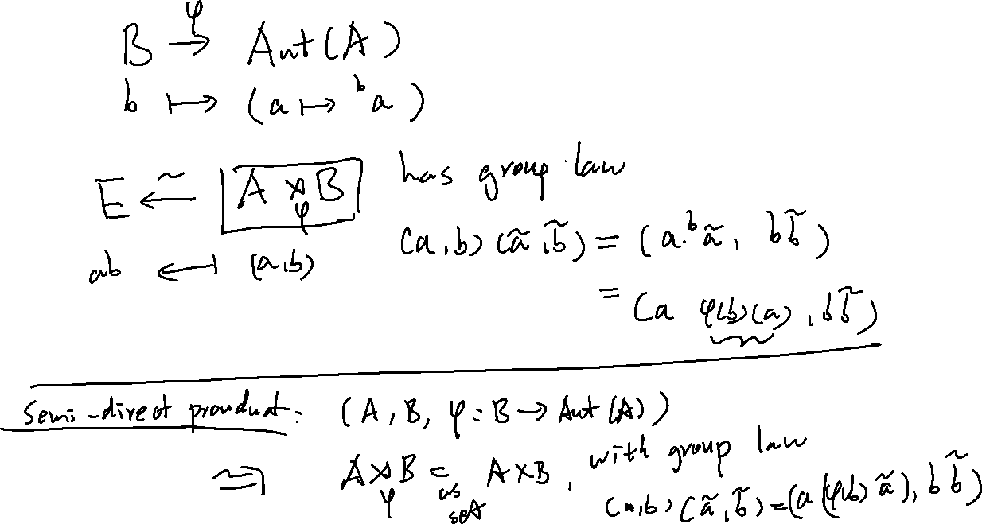

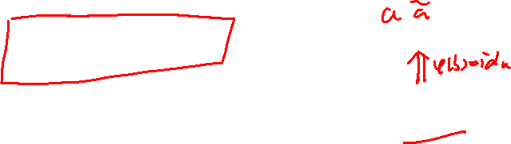

Slide 9
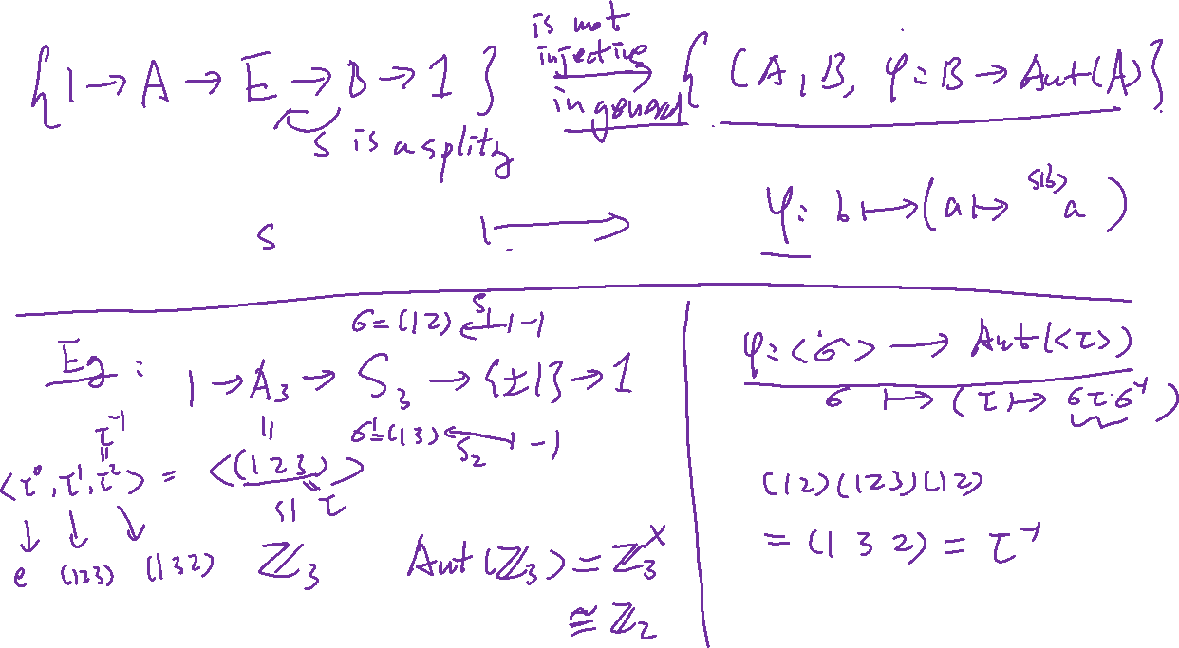

Slide 10









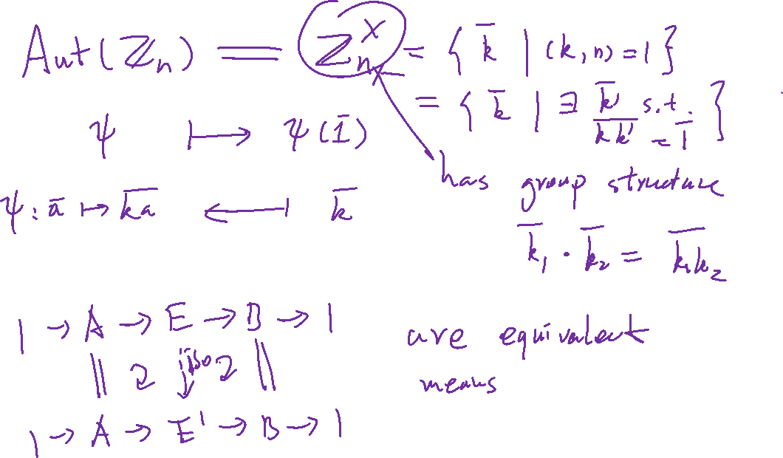















Slide 11
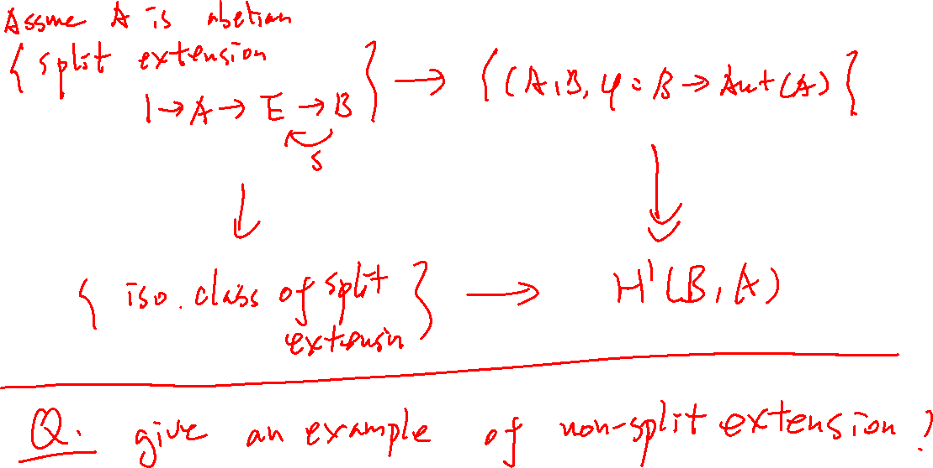

Slide 12
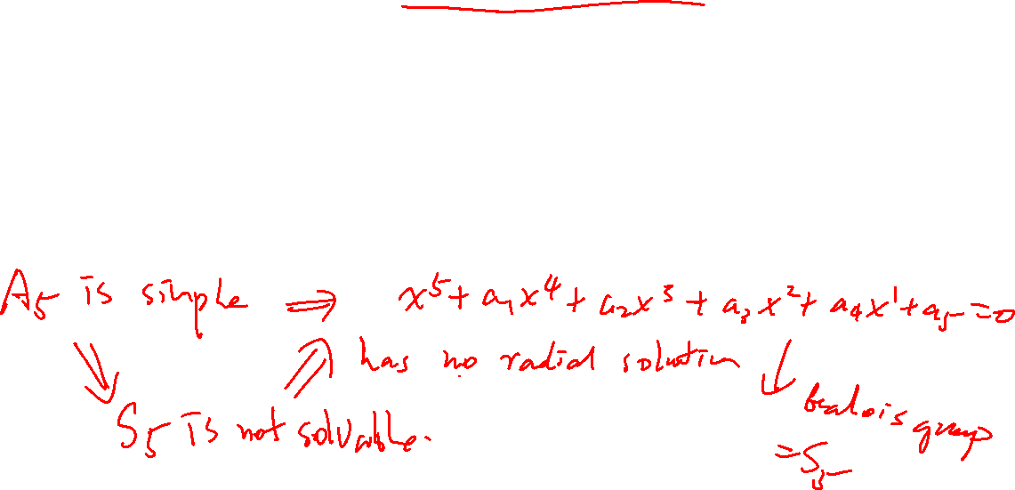
Idea: Understand possible simple factors (like atoms) appear in a group.
Simple group?
Finite Simple groups (non-trivial!)
https://en.wikipedia.org/wiki/List_of_finite_simple_groups

Slide 13
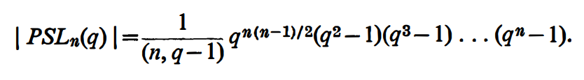
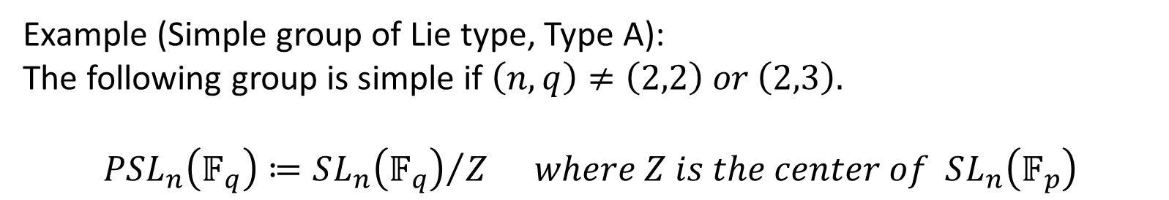
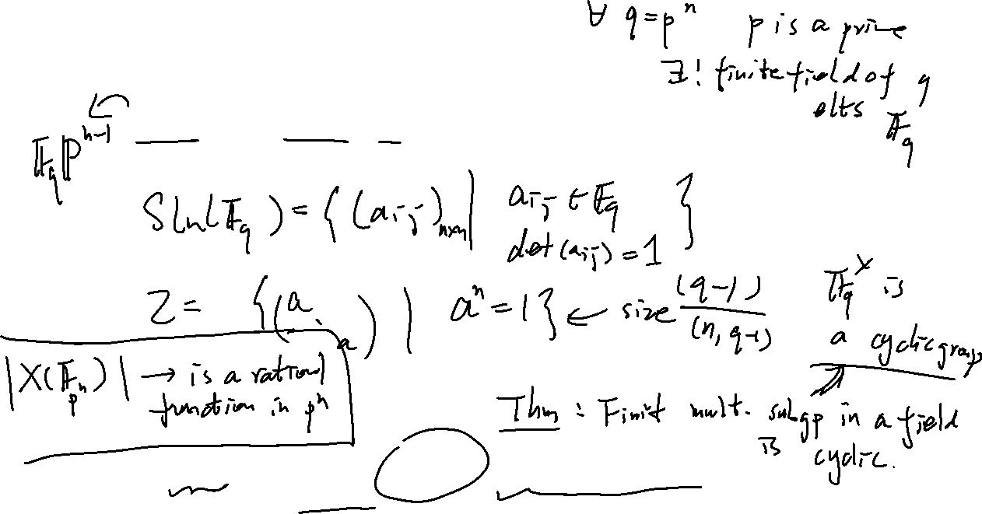
Example (Simple group of Lie type, Type A):
The following group is simple if $\left(n,q\right)≠\left(2,2\right) or \left(2,3\right).$
$$PSL_{n}\left(𝔽_{q}\right)≔{SL_{n}\left(𝔽_{q}\right)}/Z where Z is the center of SL_{n}\left(𝔽_{p}\right)$$

Slide 14
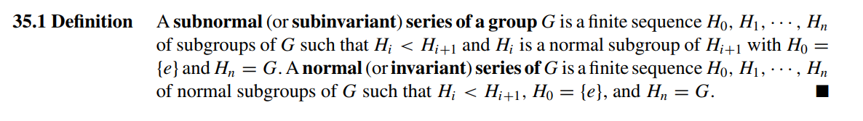
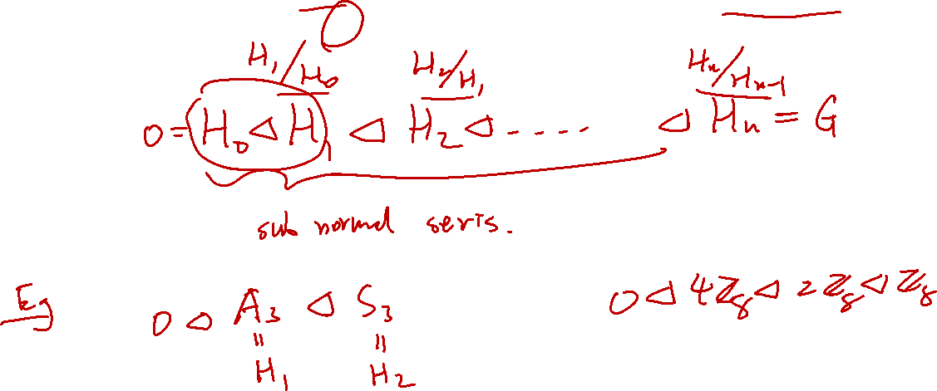

Slide 15
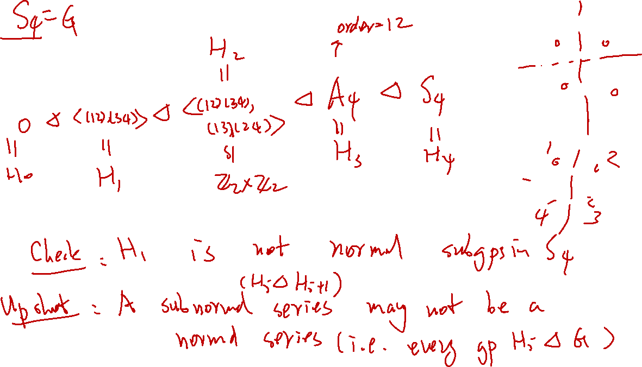

Slide 16
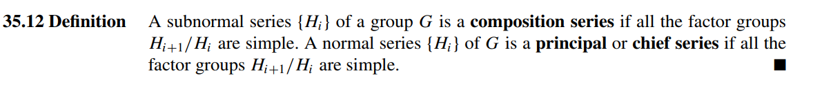


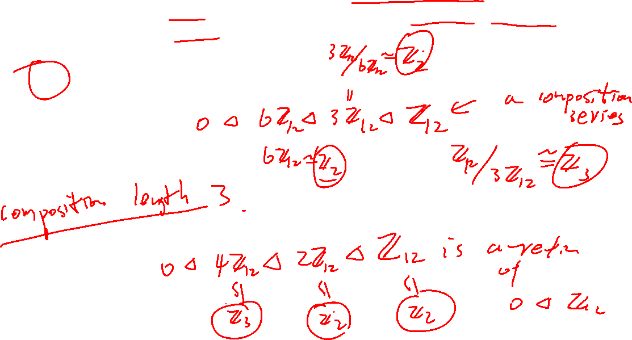
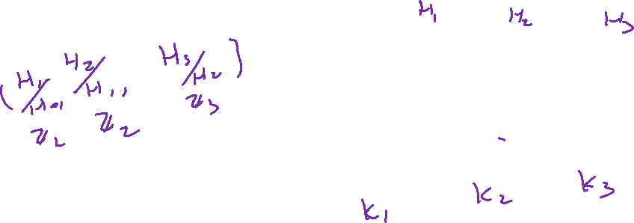
Example: $ℤ_{12}$

Slide 17
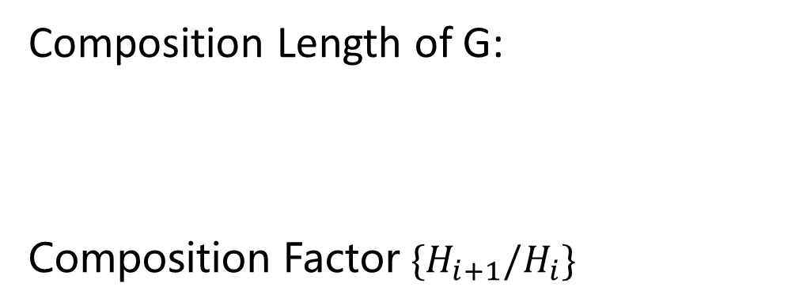
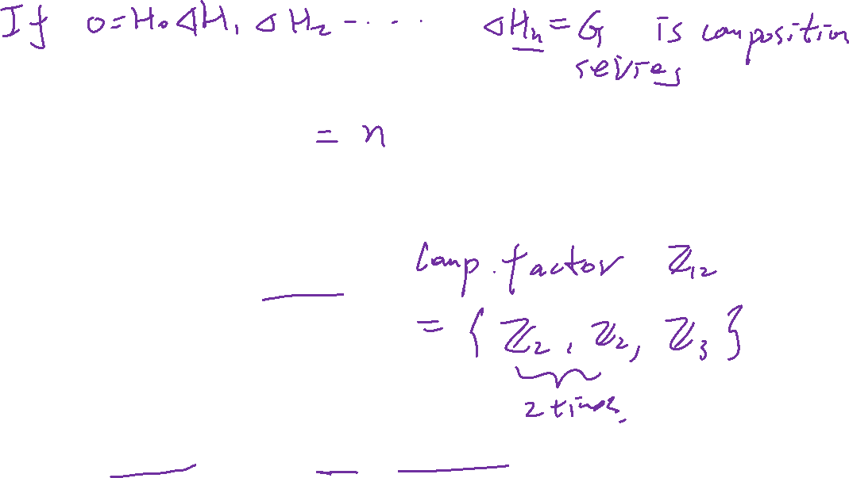
Composition Length of G:
Composition Factor $\{H_{i+1}/H_{i}\}$
Upshot: Composition Factor and Length are well-defined!

Slide 18
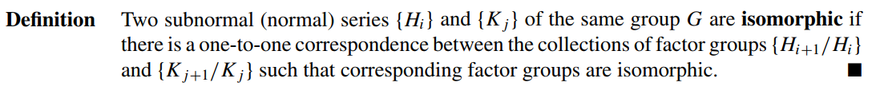

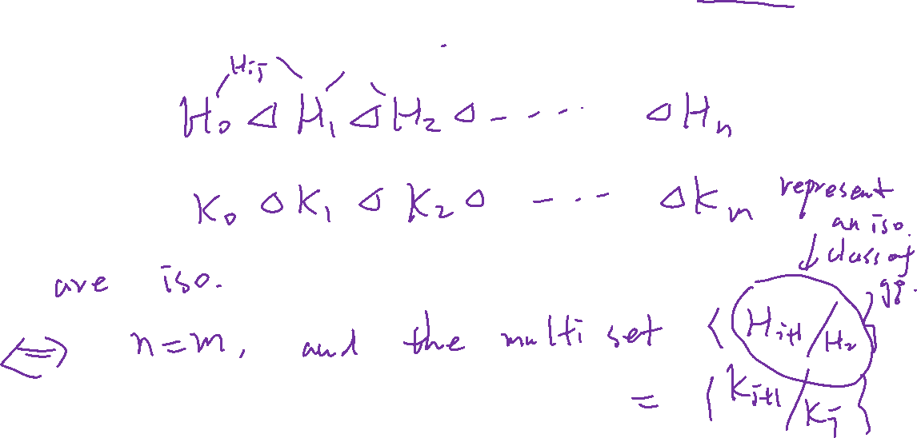

Slide 19
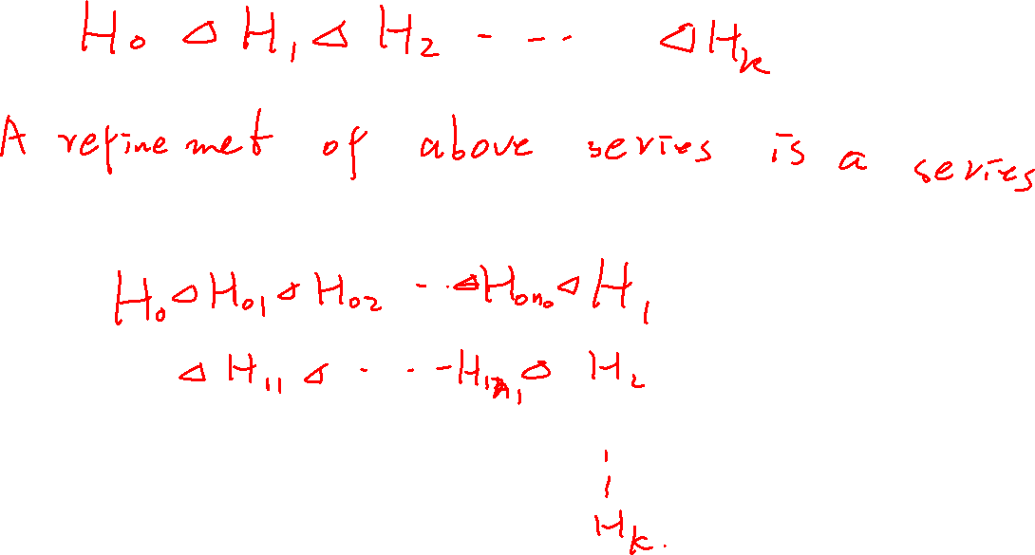

Slide 20
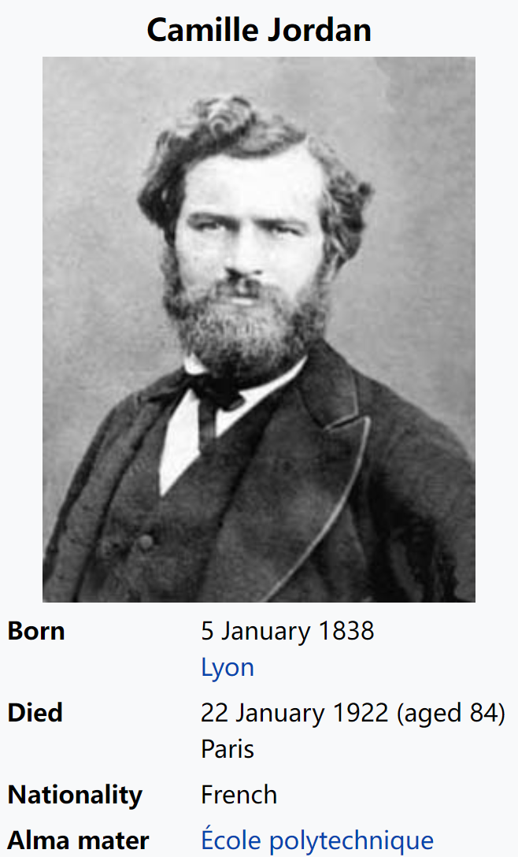
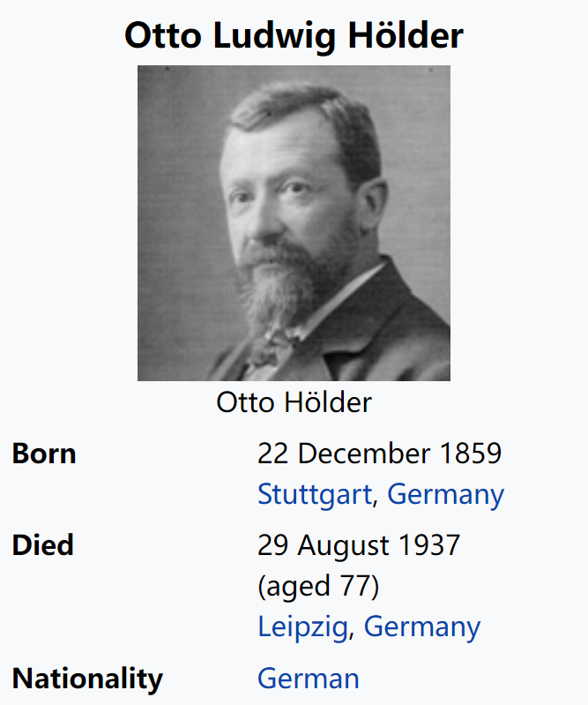

Slide 21
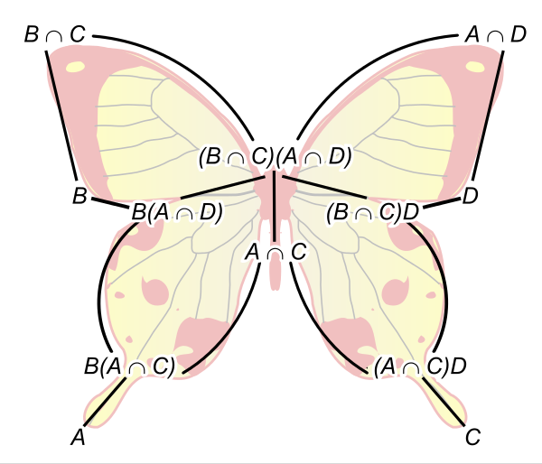
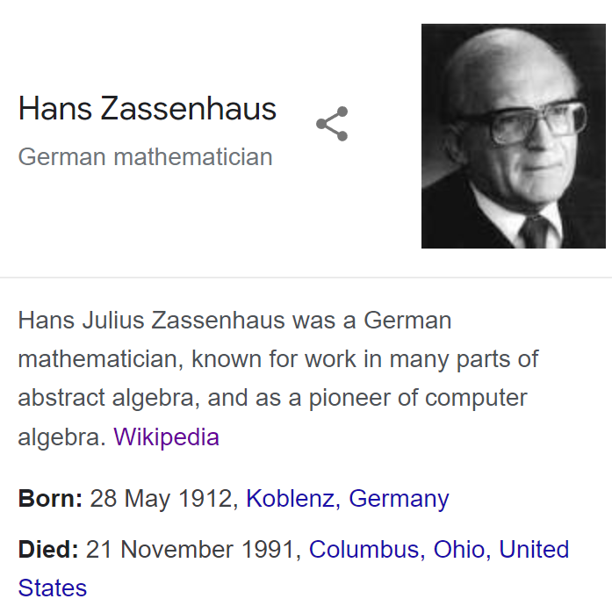
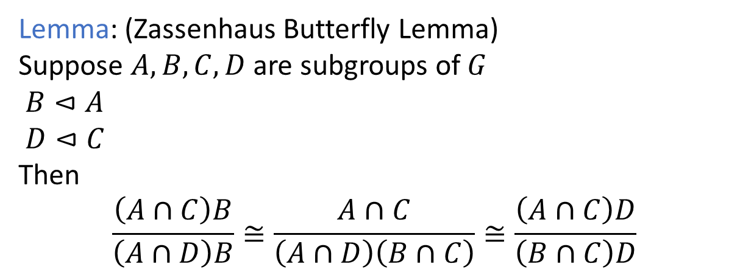
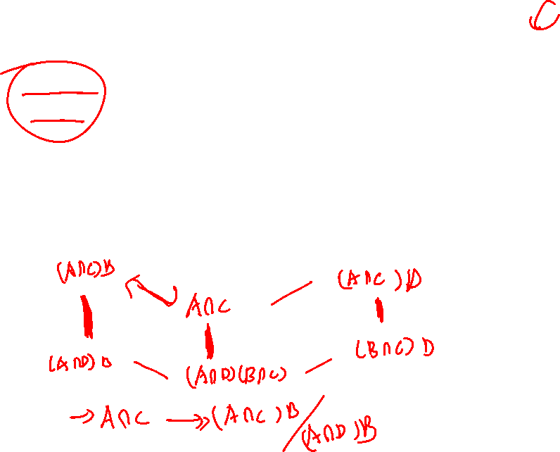
Lemma: (Zassenhaus Butterfly Lemma)
Suppose $A,B,C,D$ are subgroups of $G$
$B⊲A$
$D⊲C$
Then
$$\frac{\left(A∩C\right)B}{\left(A∩D\right)B}≅\frac{A∩C}{\left(A∩D\right)\left(B∩C\right)}≅\frac{\left(A∩C\right)D}{\left(B∩C\right)D}$$

Slide 22
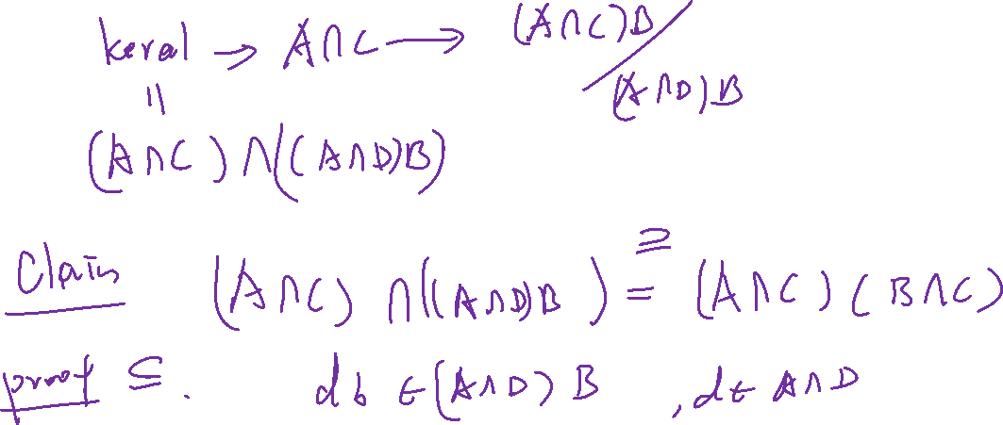

Slide 23
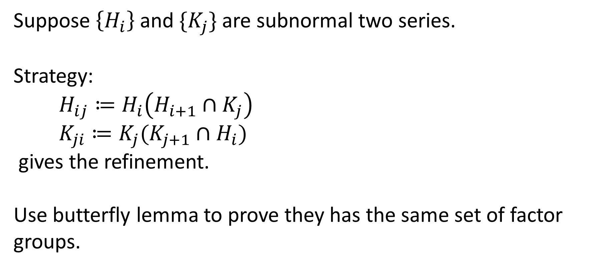
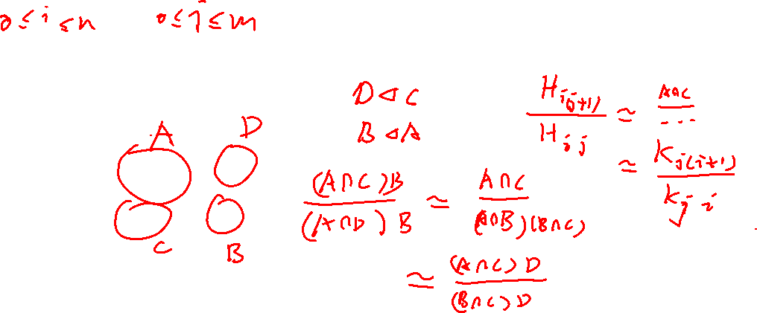

Suppose $\left\{H_{i}\right\}$ and $\{K_{j}\}$ are subnormal two series.
Strategy:
$H_{ij}≔H_{i}\left(H_{i+1}∩K_{j}\right)$
$K_{ji}≔K_{j}(K_{j+1}∩H_{i})$
gives the refinement.
Use butterfly lemma to prove they has the same set of factor groups.

Slide 24
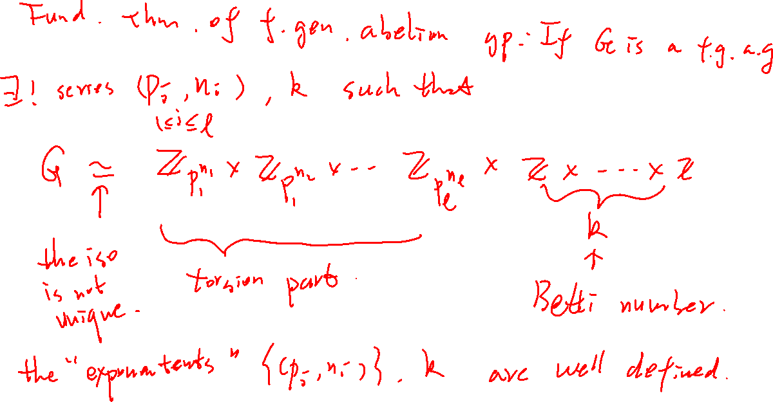

Slide 25
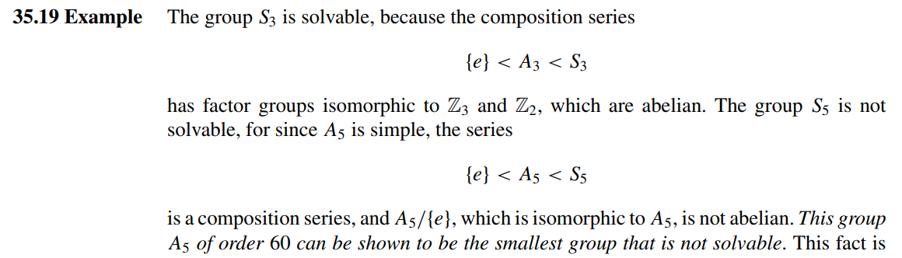
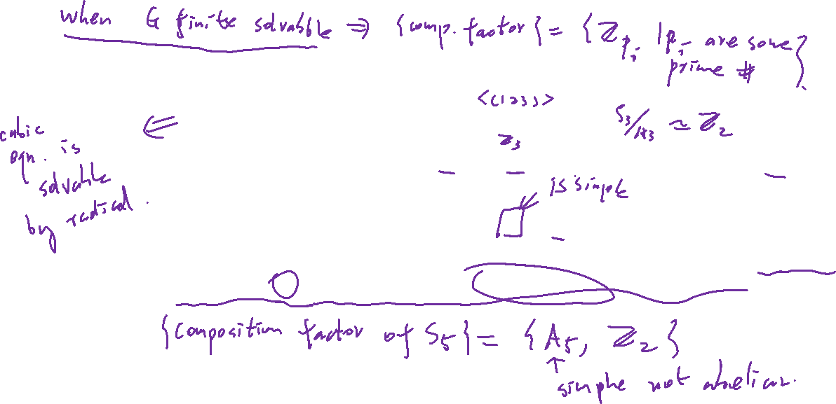


Slide 26
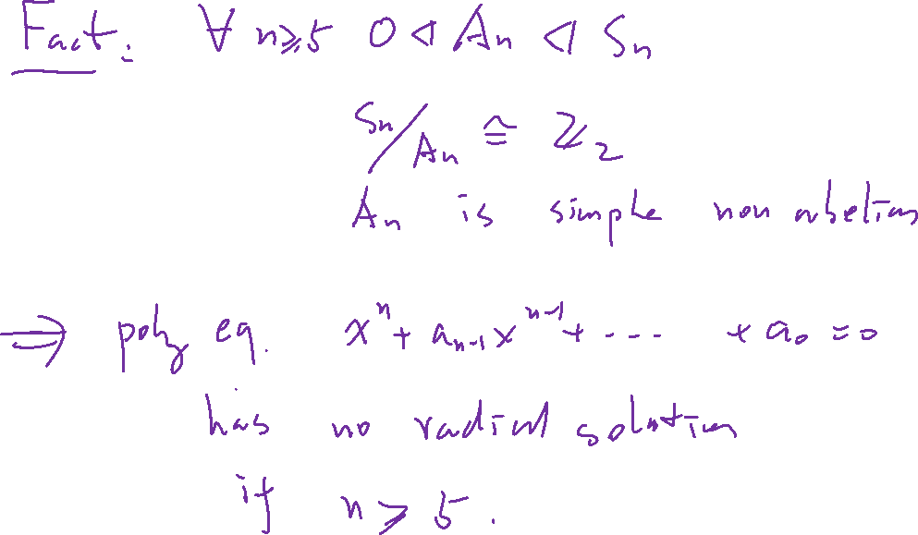

Slide 27
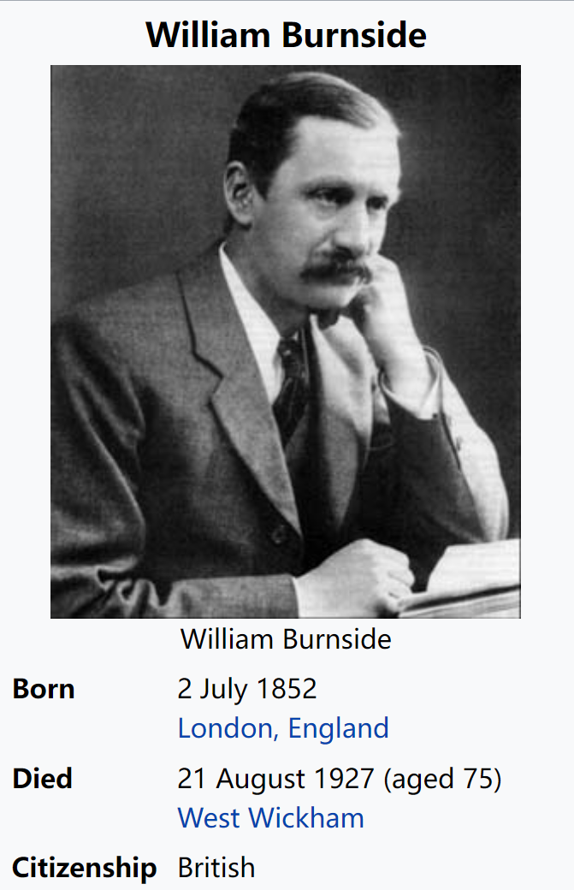
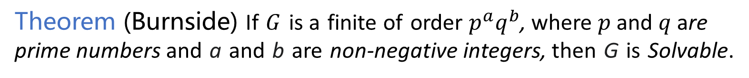
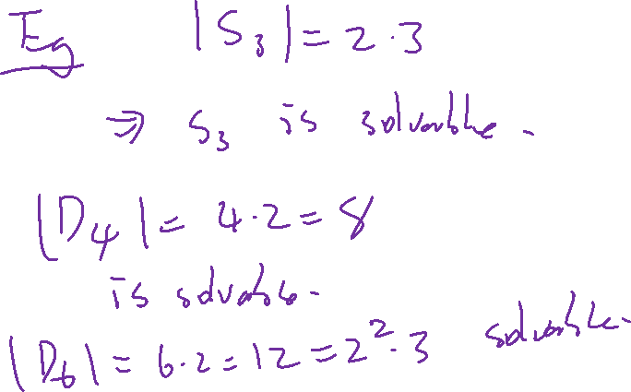
Other examples of Solvable groups
Theorem (Burnside) If $G$ is a finite of order $p^{a}q^{b}$, where $p$ and $q$ are prime numbers and a and b are non-negative integers, then G is Solvable.

Slide 28



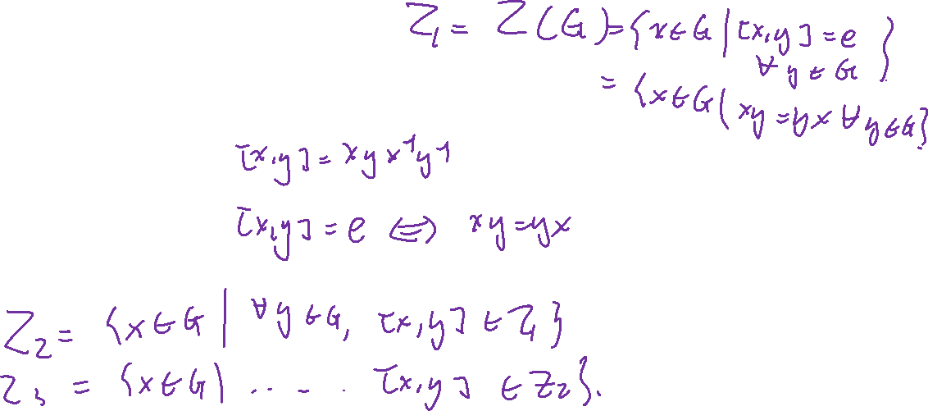
Ascending central series (Upper central series)

Slide 29
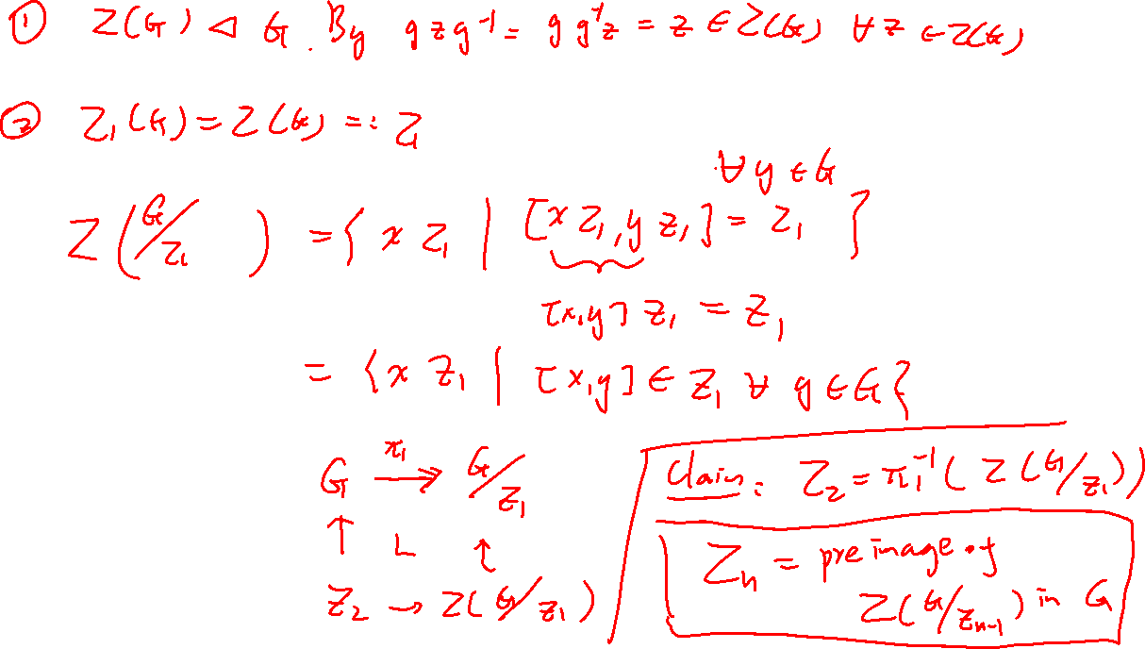

Slide 30
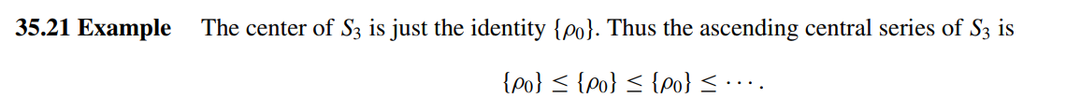
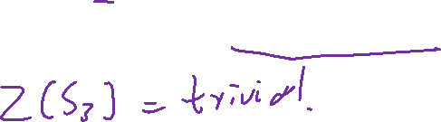
Example

Slide 31



Slide 32


Commutator of groups: $\left[H,K\right]$

Slide 33


Slide 34


Lower central series (descending central series)

Slide 35



Nilpotent group
A group is called a nilpotent group
$⇔$ its upper central series terminates at $G$
$⇔$ its lower central series terminates at $1$
Example of nilpotent group:
$D_{4}$

Slide 36


Slide 37


One more example
$N≔\left\{1+strictly upper trianguler matrix\right\}$

Slide 38


Slide 39


Slide 40


Derived Series
Lemma: $G$ is solvable if and only if $G^{(n)}=1$ for some $n$.

Slide 41








